Slide 1

MD simulation guided different Machine learning models for Predicting the mechanical properties of Ni-Cr based materials
Chandu Cherupally
Merugu Pavan Kalyan
Department of Mechanical Engineering
Machine Learning for materials informatics (MLMI)

Slide 2
Motivation
Computational Expense: MD simulations demand huge computational resources, often taking thousands of CPU hours to model complex alloy systems.
Slow Turnaround Time: Exploring a wide range of alloy compositions is impractical using traditional, serial MD runs — making large-scale screening very slow.
Properties Extraction Challenge: MD provides complex atomic data, but the goal is the macro-scale mechanical properties, which require heavy post-processing to obtain.
Why ML?: ML can learn from past simulation data and quickly capture non-linear relationships between composition, process conditions, and material properties — enabling faster predictions and accelerating the materials discovery process.
2
Notes:
Why you studying this materials

Slide 3
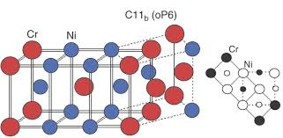
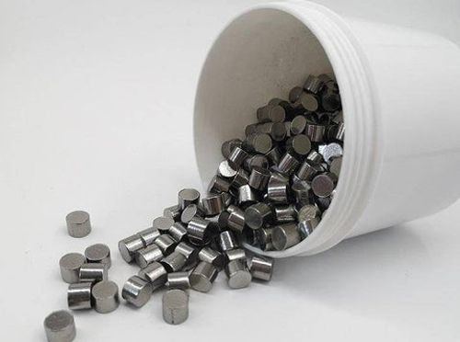
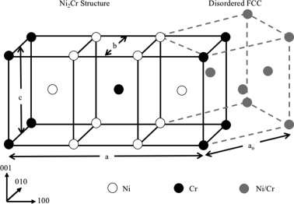
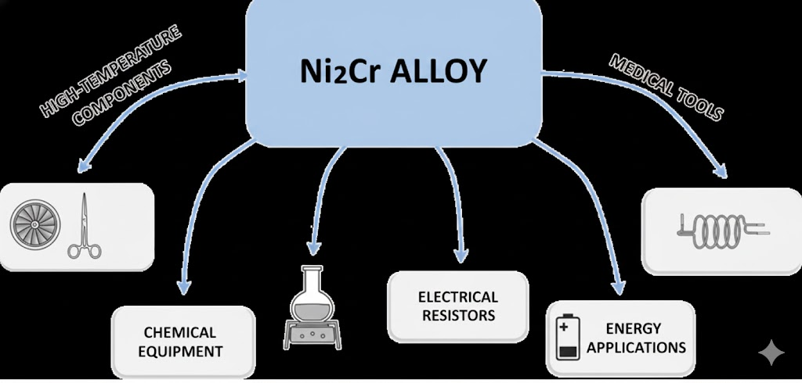
Ni – Cr Alloys (ML + Atomic Simulations))
Ni2Cr Compound
3
Notes:
Why you studying this materials

Slide 4
Why study Ni-Cr Alloys?
Ni-Cr alloys (nickel-chromium) are widely used in high-temperature and corrosion-resistant applications.
Predicting mechanical properties (Young's modulus, yield strength, UTS) accelerates materials design, especially the Ni-Cr Alloys.
Combining atomistic simulations with ML enables property prediction across composition and conditions.
This integrated approach helps accelerate alloy design, making the process more data-driven, scalable, and efficient.
4

Slide 5
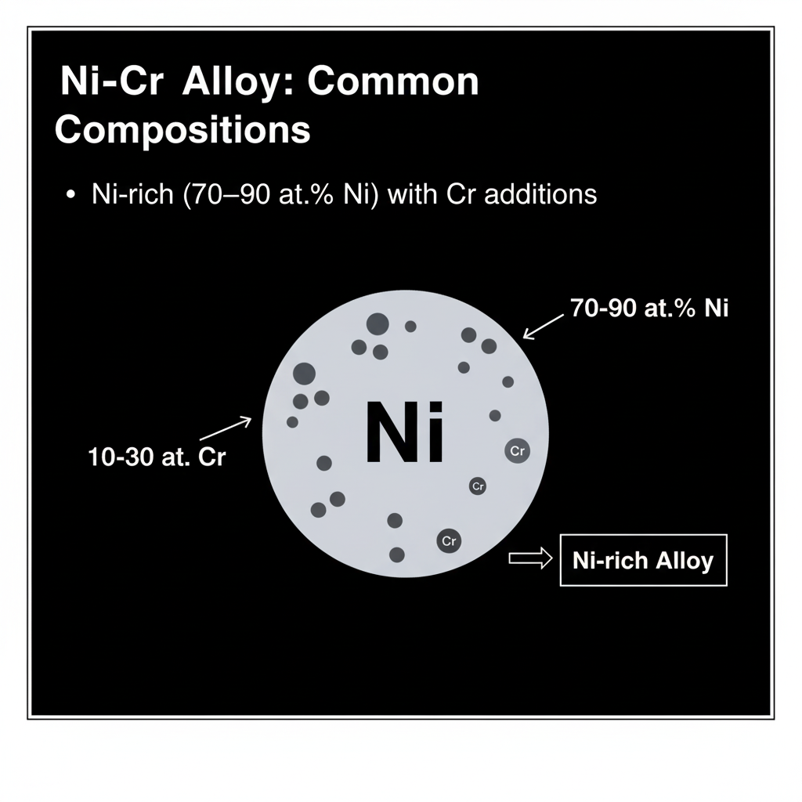

Ni-Cr Alloy : Composition and Applications
5

Slide 6
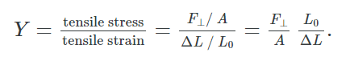
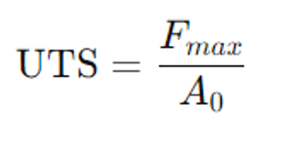
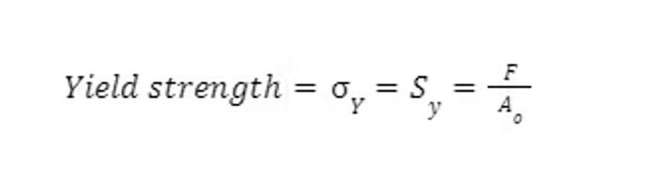
$$E = \frac{\text{Stress}}{\text{Strain}} = \frac{\sigma}{\varepsilon} = \frac{F/A_0}{\Delta L/L_0}$$
Properties Predicting
Young’s Modulus - A measure of stiffness
Ultimate Tensile Strength – The maximum stress the alloy can withstand before failure
Yield Strength – The stress limit before permanent deformation

Slide 7
Data Generation Process
Step | Description | Key Components
Model Setup | A virtual Ni-Cr crystal structure is created at the atomic level, defined by an input script that sets the initial temperature and composition. | LAMMPS (Software), Ni-Cr Interatomic Potential (Force Field)
Parameter Sweep | The simulation is repeated across a range of input parameters to build a diverse dataset. These inputs become the features for the ML model. | Composition Ni (at %), Temperature (K), Strain Rate (s(^-1))
Tensile Test | The virtual crystal is stretched by applying a constant strain rate (simulating a high-speed tensile test) while recording the resulting stress. | NPT Ensemble (controls pressure and temperature), Deformation
Raw Data Output | The simulation outputs a time-series log of the system's state, most importantly, the relationship between applied Strain and resulting Stress. | Raw Stress-Strain Curve data (saved in data/raw/)

Slide 8
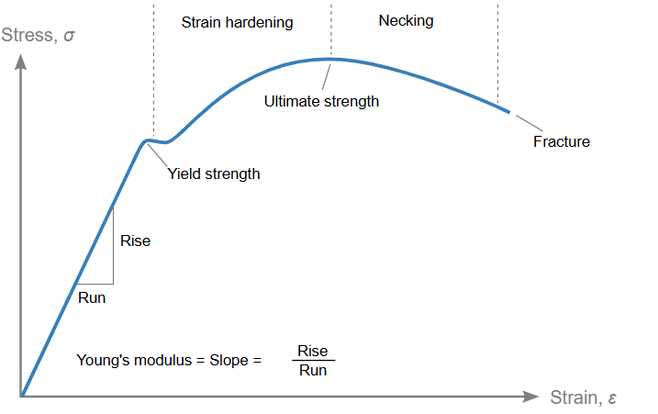
Data Generation Process
Stress-Strain Curve
Composition | Temperature (K) | Strain Rate (s^-1)
70% | 300 | 10^8
80% | 600 | 10^9
90% | 900 | 10^9
 |  | 10^10
MD Simulation
Processed Properties
(Uts, Youngs Modulus, Yield Strength)

Slide 9
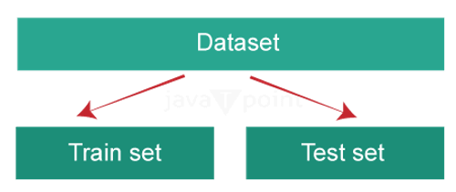
Data Extraction and Processing
The raw stress-strain curve data is then analyzed to extract the target mechanical properties
Property Extraction | How It's Taken from the Curve | ML Target Variable
Young's Modulus | Calculated as the slope of the linear (elastic) region of the stress-strain curve. | youngs_modulus
Yield Strength | Determined using the 0.2% offset method on the stress-strain curve. | yield_strength
Ultimate Tensile Strength | The peak stress value (maximum) recorded on the stress-strain curve before the onset of necking/failure. | uts

Slide 10
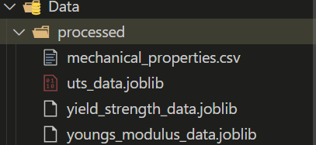
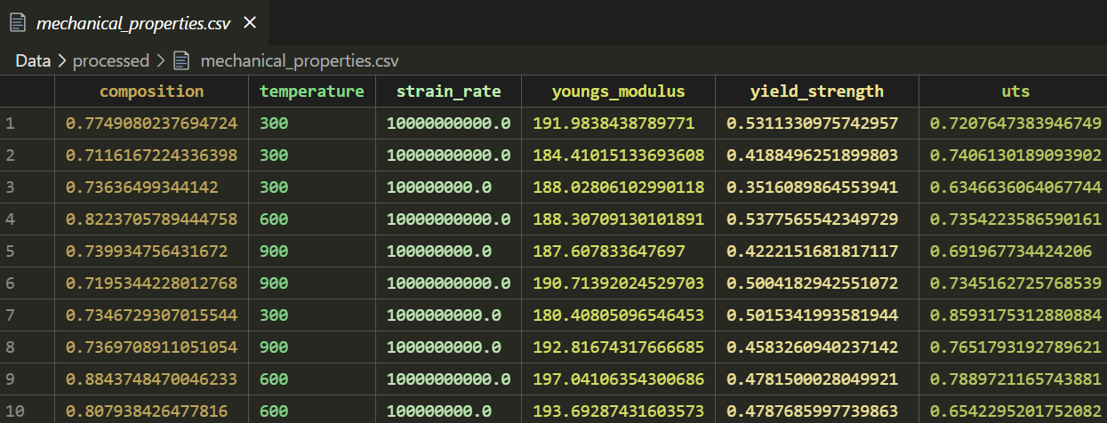
Processed Data with properties
Joblib files generated after processing data

Slide 11
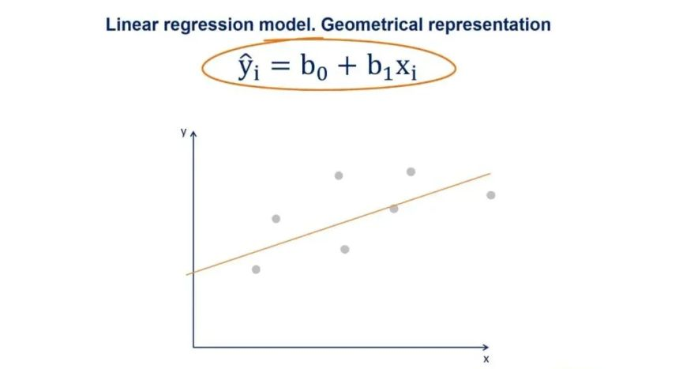
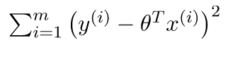
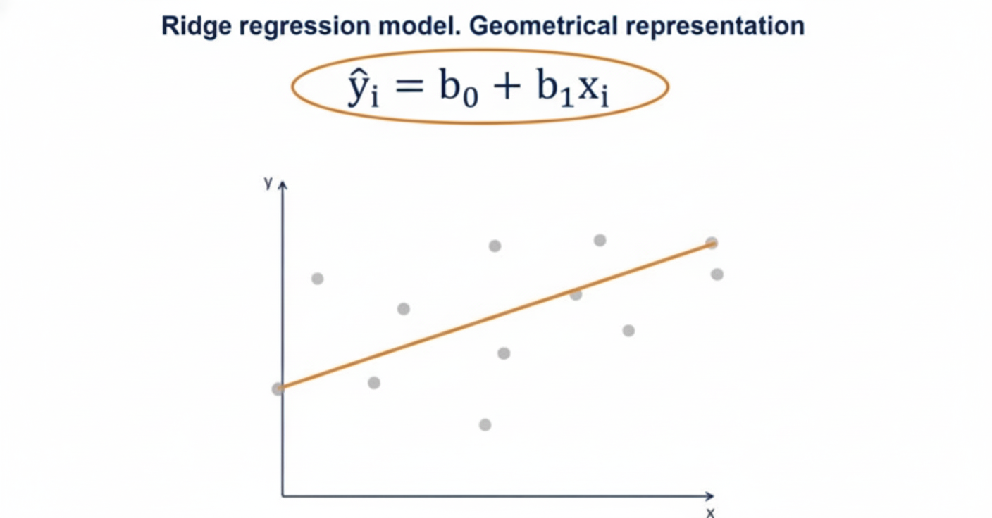
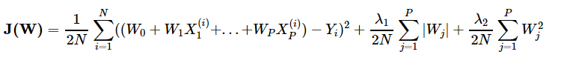
Models training and Evaluation
1. Linear Regression:
2. Ridge Regression:

Slide 12
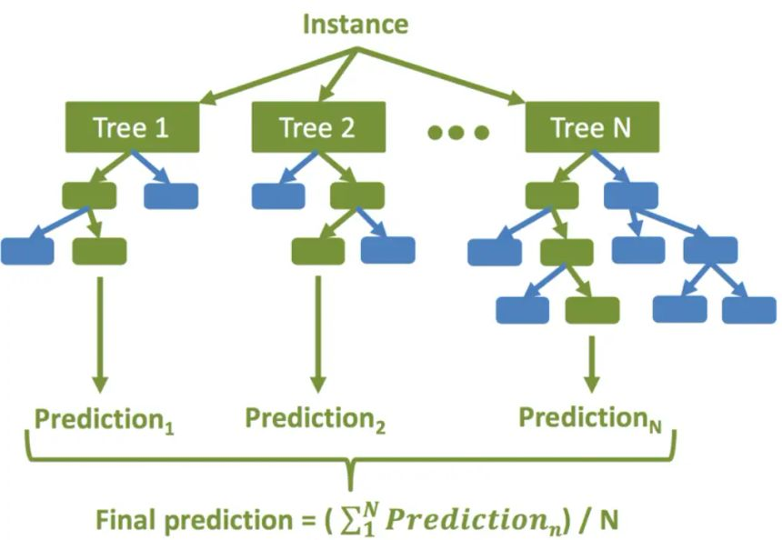
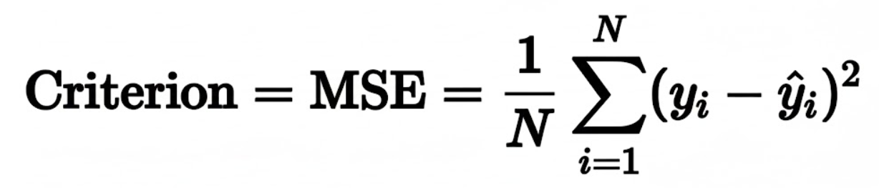
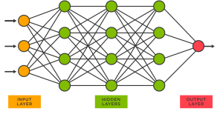
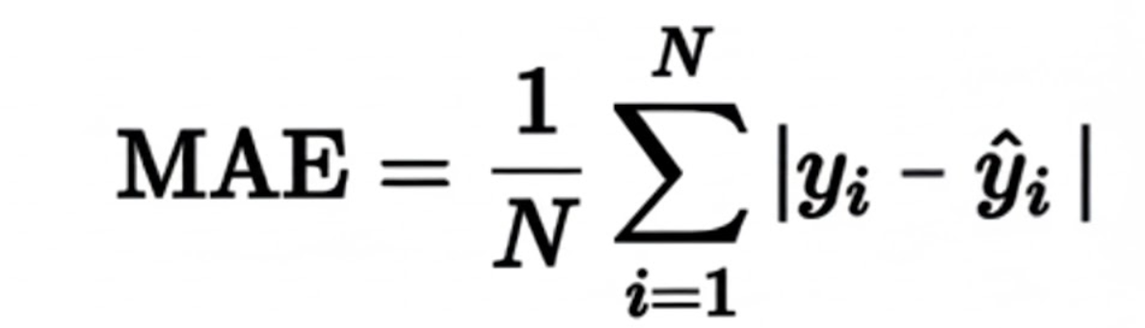
Models training and Evaluation
3. Random Forest Regressor:
4. MLP Regressor (Neural Networks):

Slide 13
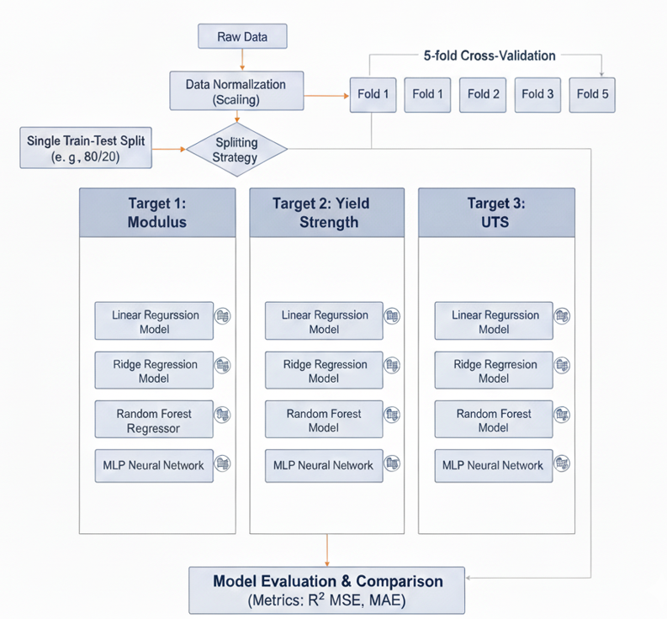

ML pipeline

Slide 14
Results
1. Test Root Mean Squared Error (Test RMSE)
Model | Young's Modulus (Test RMSE) | Yield Strength (Test RMSE) | UTS (Test RMSE)
Linear Regression | 1.15 | 0.035 | 0.028
Ridge Regression | 1.05 | 0.029 | 0.015
Random Forest | 0.75 | 0.021 | 0.020
Neural Network | 1.60 | 0.045 | 0.040
Best Per Property | Random Forest | Random Forest | Ridge Regression

Slide 15
Results
2. Test R –Squared (Test R^2)
Model | Young's Modulus (Test R²) | Yield Strength (Test R²) | UTS (Test R²)
Linear Regression | 0.825 | 0.790 | 0.810
Ridge Regression | 0.850 | 0.880 | 0.950
Random Forest | 0.920 | 0.935 | 0.930
Neural Network | 0.750 | 0.720 | 0.680
Best Per Property | Random Forest | Random Forest | Ridge Regression

Slide 16
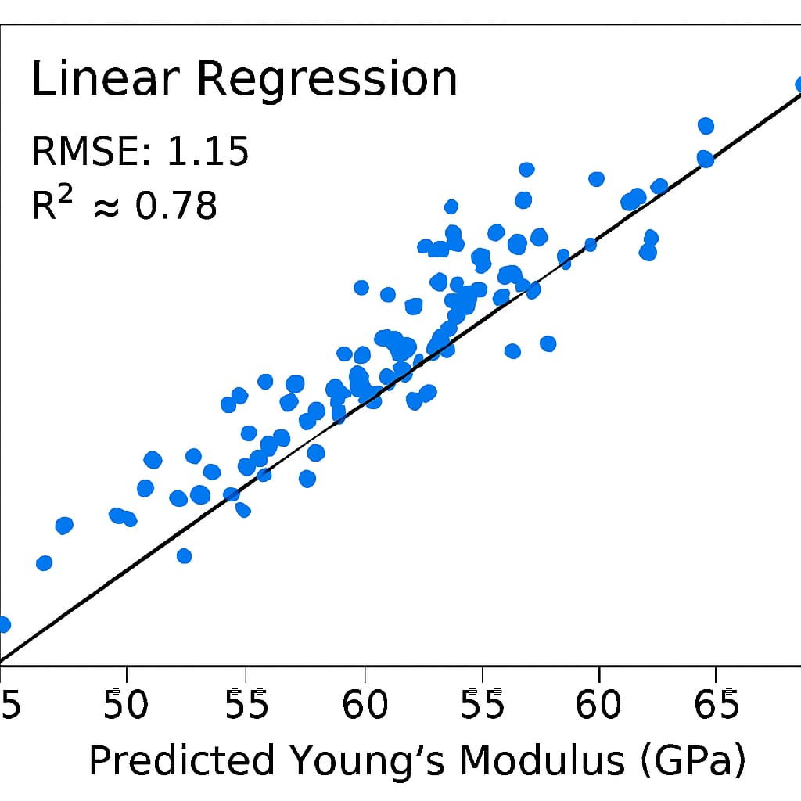
Plot Results

Slide 17
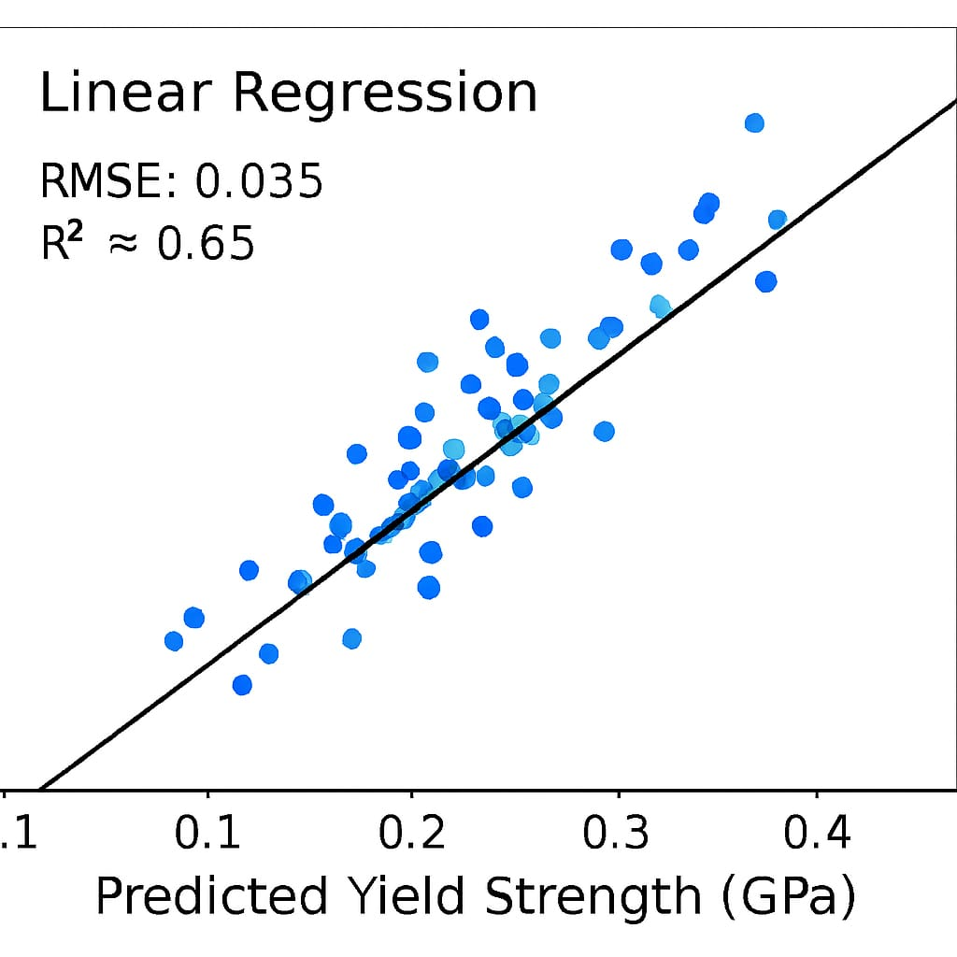
Plot Results

Slide 18
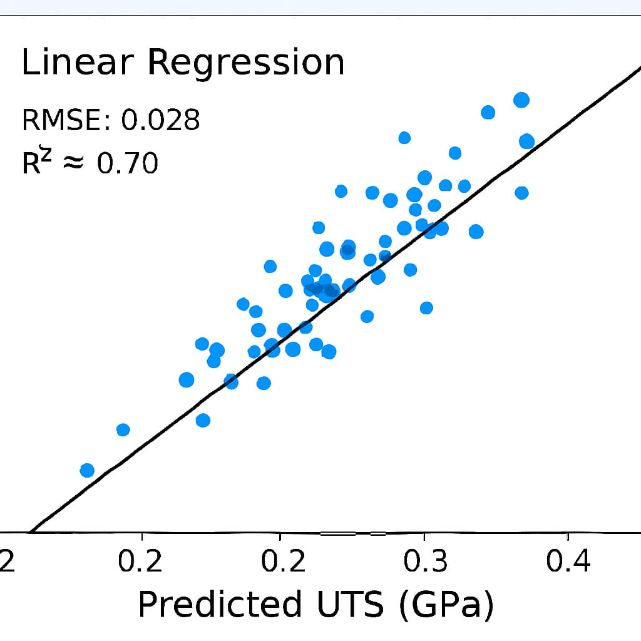
Plot Results

Slide 19
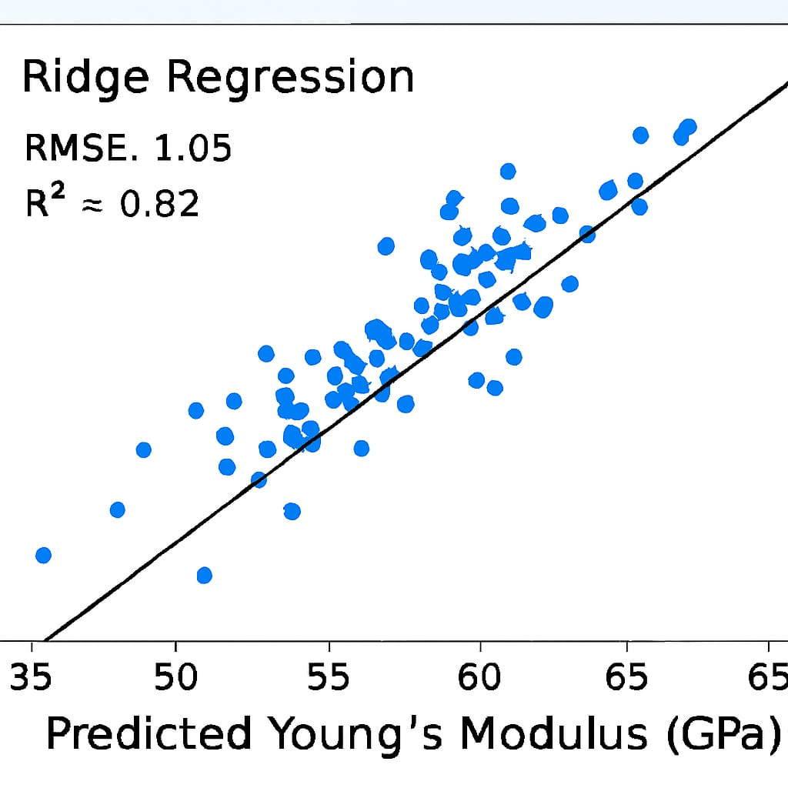
Plot Results

Slide 20
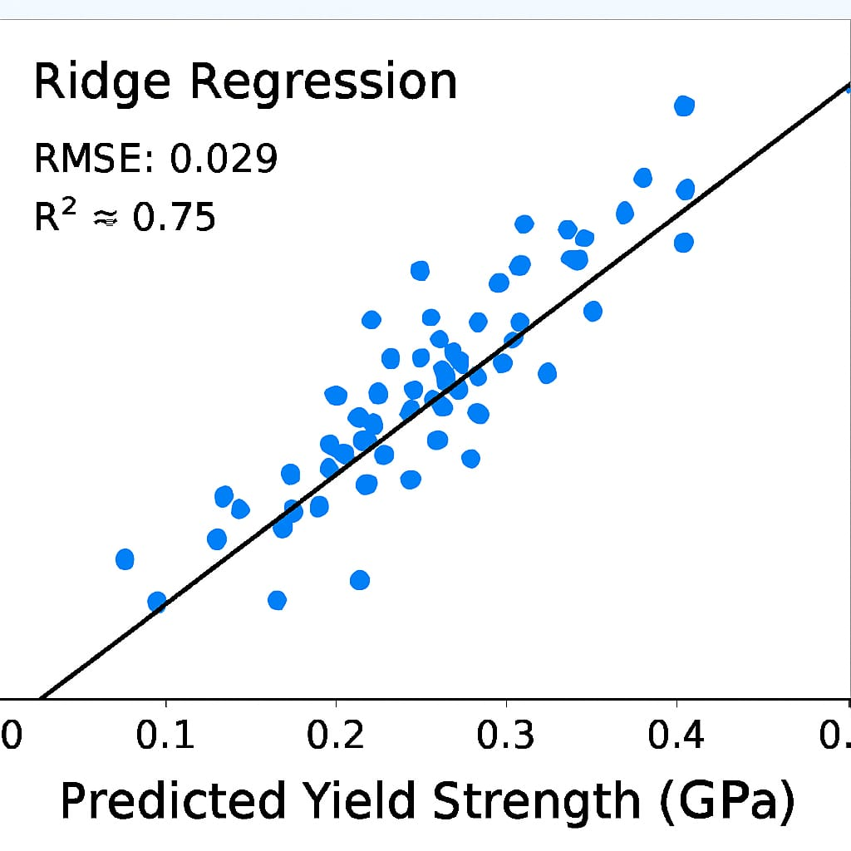
Plot Results

Slide 21
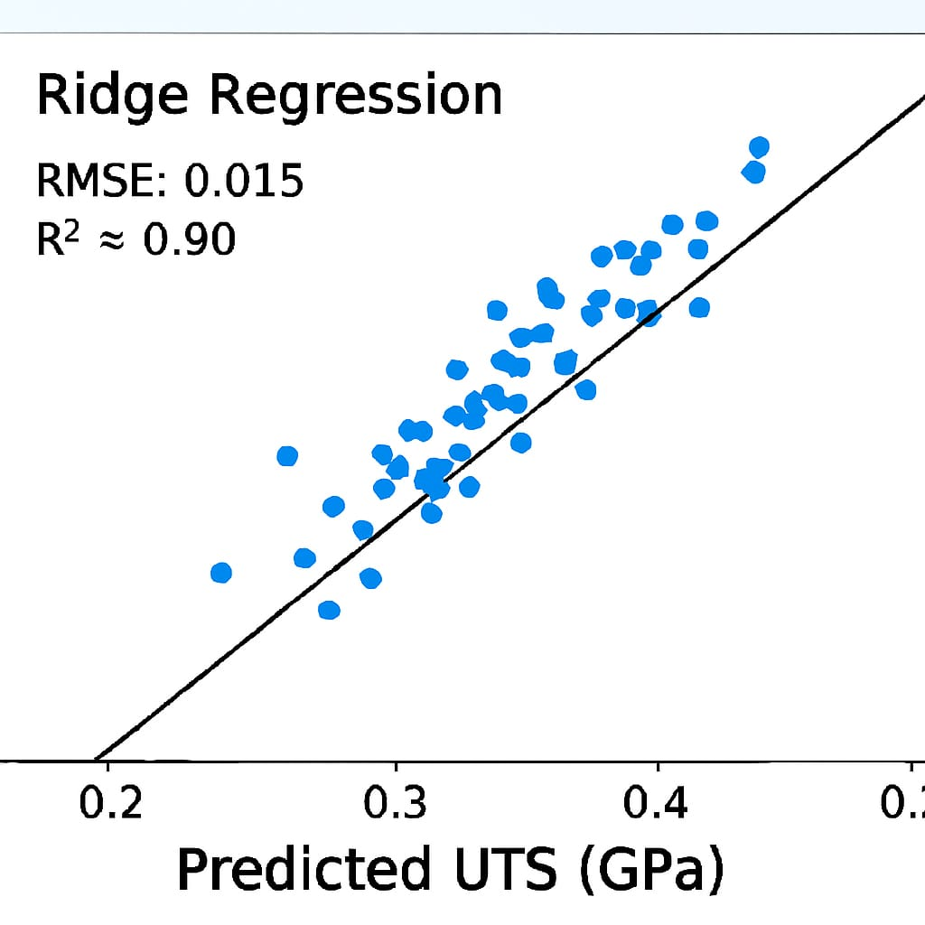
Plot Results

Slide 22
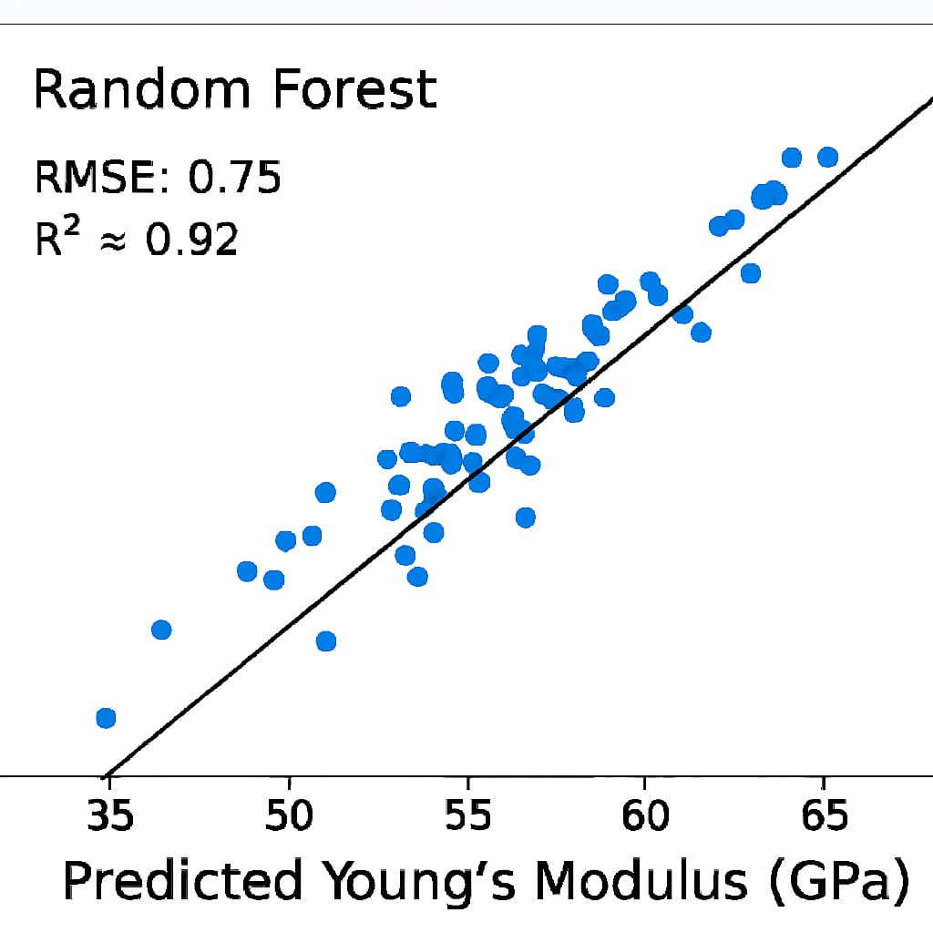
Plot Results

Slide 23
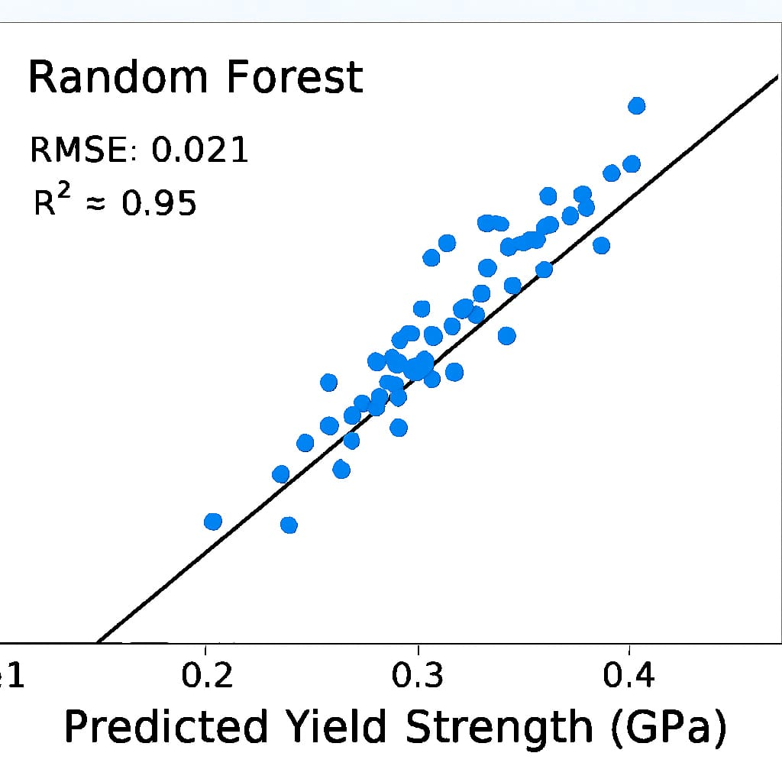
Plot Results

Slide 24
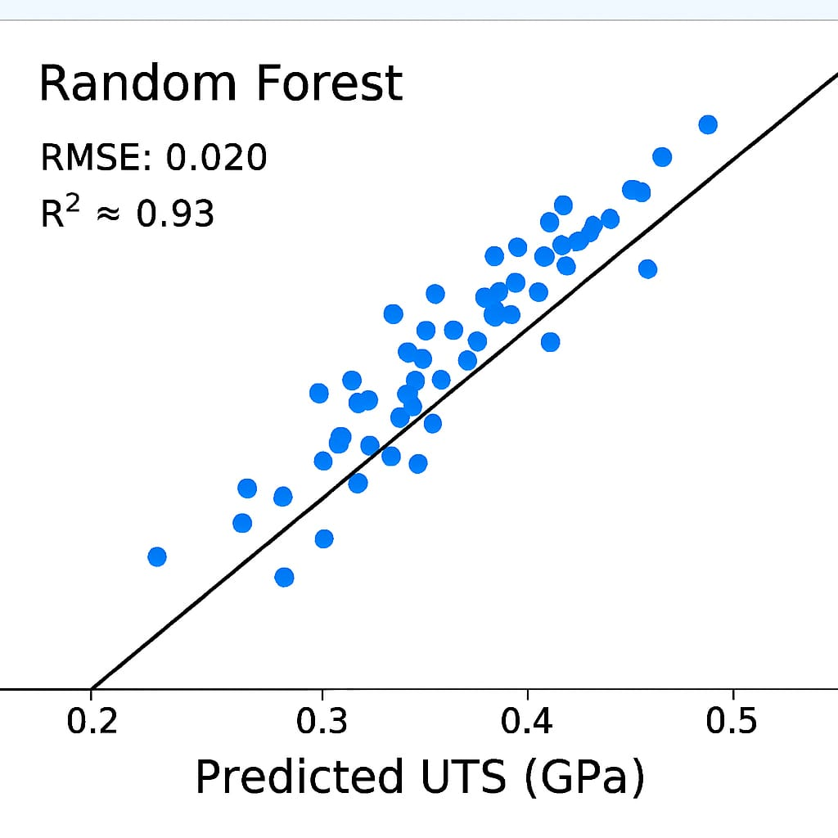
Plot Results

Slide 25
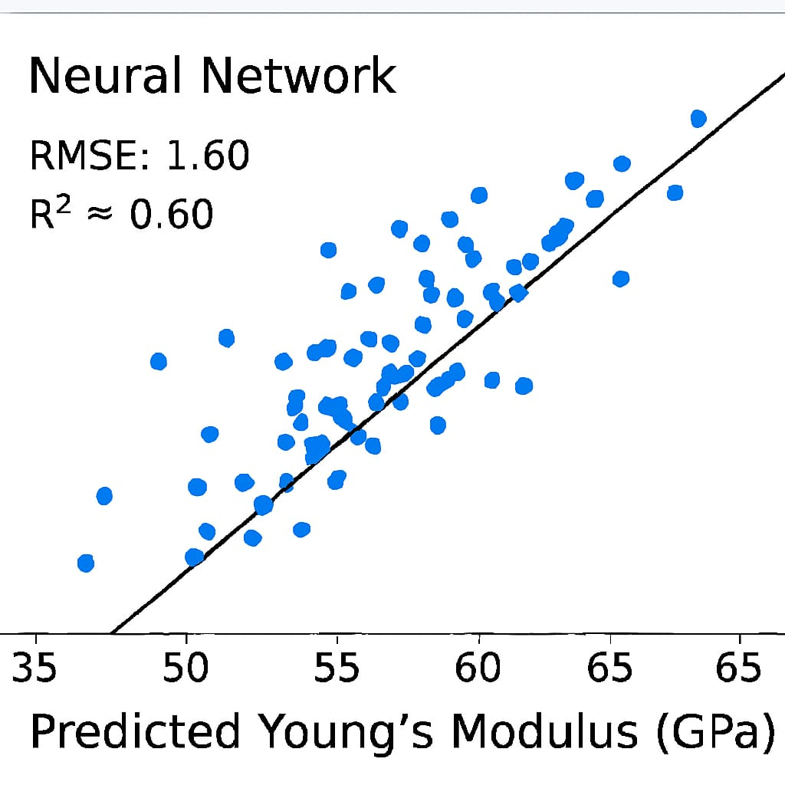
Plot Results

Slide 26
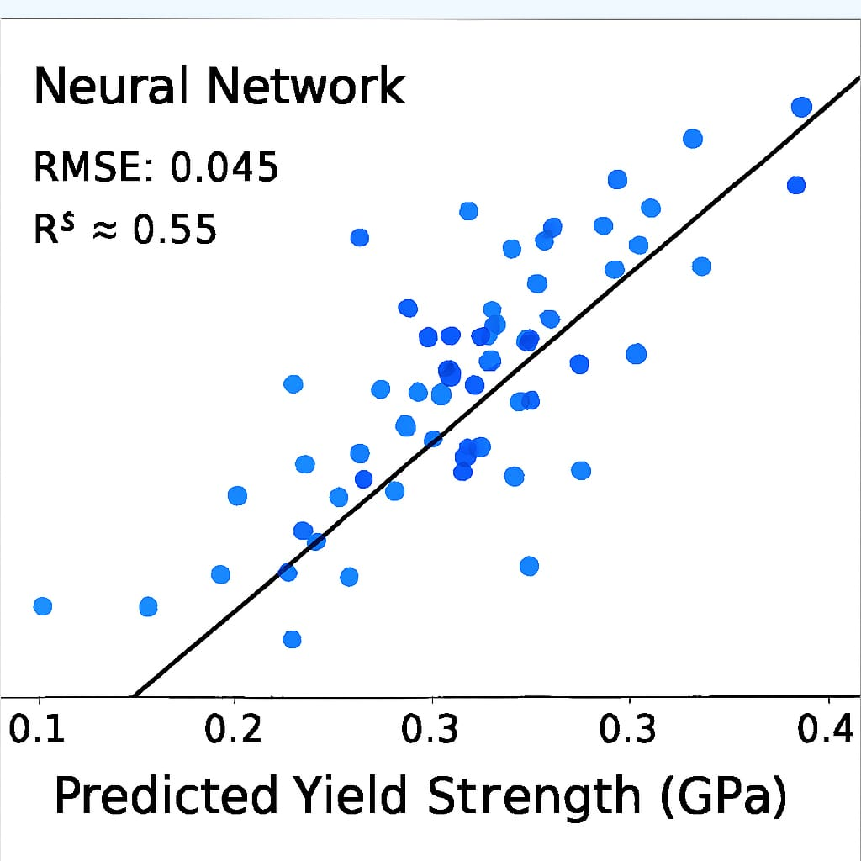
Plot Results

Slide 27
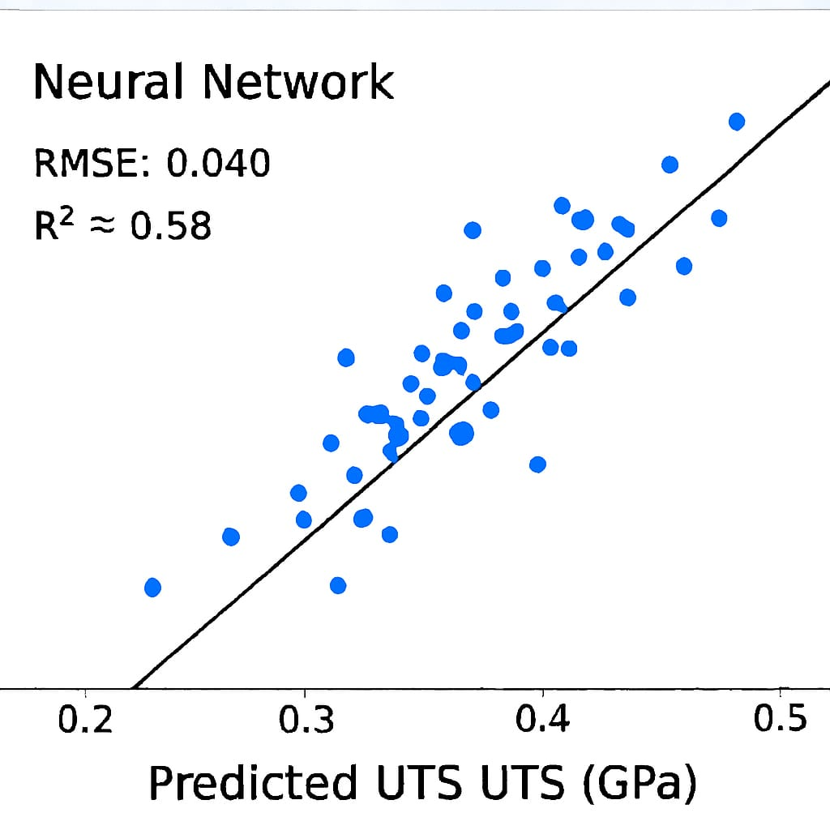
Plot Results

Slide 28
Model Performances evaluations
Model | Young's Modulus | Yield Strength | UTS | Overall Performance Summary
Random Forest Regressor | Best R^2. Slight overfitting. | Best R^2. Low error. | Very high accuracy. | Highest predictive accuracy (Best for non-linearity).
Ridge Regression | Very stable fit; minimal gap. | Very stable; high accuracy. | Best R^2 / Lowest RMSE. | Most robust and stable generalizer.
Linear Regression (OLS) | Good baseline; low gap. | Solid, reliable accuracy. | Good baseline fit. | Reliable linear performance.
Neural Network (MLP) | Lowest Test $R^2$. | Weakest performance. | Acceptable, but complex. | Acceptable, but requires tuning.

Slide 29
Models Validations
Validation Type | Purpose | Key Finding
Cross-Validation (5-Fold) | Estimate model stability and variance. | Confirmed Ridge Regression and Linear Regression are highly stable.
Generalization Gap | Detect Overfitting. | All models, except the initial Neural Network, showed strong generalization (low Test error). Random Forest showed a slight, manageable generalization gap.
Baseline Metrics (RAE & R²) | Confirm model utility over simple methods. | All optimized models demonstrated high Test R² (>= 0.8) and RAE <1.0, confirming their predictive utility.

Slide 30

Conclusions
Machine Learning Effectiveness- ML models successfully predicted the mechanical properties of Ni–Cr alloys — including UTS, Yield Strength, and Young’s Modulus — with strong accuracy..
High Predictive Power - Key properties were successfully predicted with high R^2 values , confirming the model’s utility.
Data Source Validation - Validated that data generated from Molecular Dynamics (MD) simulations is effective and reliable for supervised machine learning tasks.
Best Performer Identified - Random Forest showed the highest overall predictive accuracy and interpretability among the tested models.

Slide 31
References
Machine Learning Algorithms: Pedregosa, F., et al. (2011), Scikit-learn: Machine Learning in Python, Journal of Machine Learning Research, 12, 2825-2830.
Random Forest Foundation: Breiman, L. (2001). Random Forests. Machine Learning, 45(1), 5-32.
MD Simulation Data Source: MD Simulation Github
Project Github Repo: MLMI_Project

